Slide 1
The Use of Artificial Intelligence to Predict Fraud
Nicholai Shaw, Zachary Kroell, Timothy Coleman, Jessica Morris, Chris Moeglin

Slide 2
Data Story (Credit Card Transactions Fraud Detection Dataset)
Our dataset takes the transaction data from the duration of January 2019 to December 2020. Where it covers 1000 customers who made purchases at 800 different businesses. Our goal was to create a model to display our data and show trends on the transactions that were happening. The models created were the random forest model and logistic regression model. We also used Tableau and SQLite to manipulate the data to show where the transactions were happening and to also show percentages on the types of transactions made. All of the transactions were rooted in the US and include the majority of the states.
(Shenoy, 2020)

Slide 3
The Dataset
Data of 111,144 transactions were collected
Data consisted of:
Transaction ID
Date and time
Credit Card Number and Transaction Number
Credit Card Owner’s First and Last Names
Merchant Name and Category
Geographic Information (lat, lon, street, zip, state, city)
City population
Date of Birth
Fraud status (If transaction was fraudulent or not)
Amount of Transactions

Slide 4
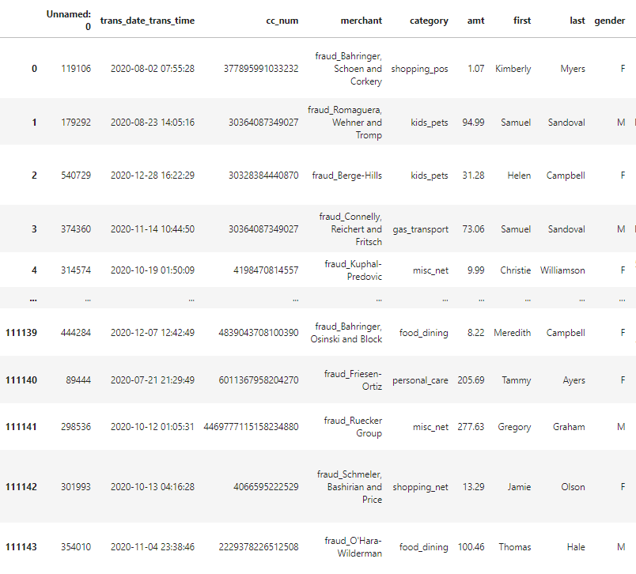
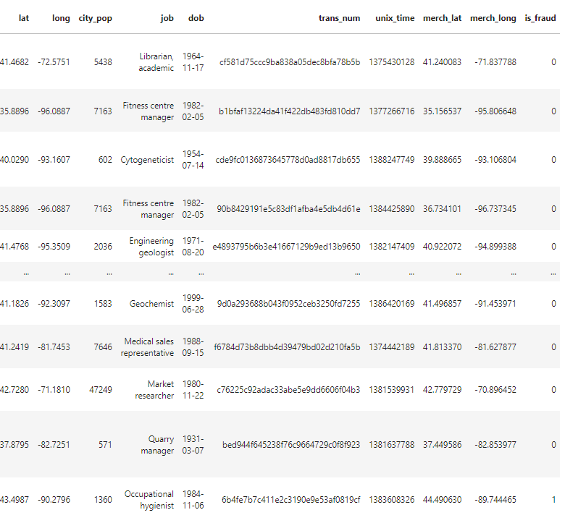
The Dataset

Slide 5



Data Cleaning
Read csv files into pandas dataframe
Renamed two columns:
'Unnamed: 0' : 'transaction_id'
'amt' : 'amount'

Slide 6
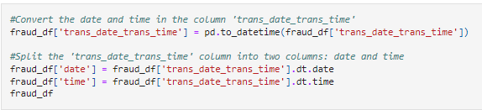
Data Cleaning
Separated the date and time into different columns

Slide 7
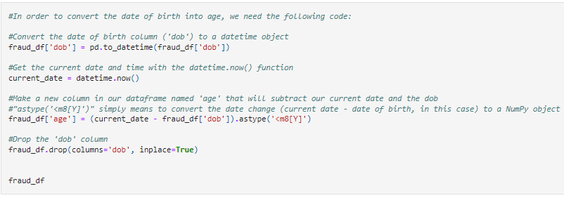
Data Cleaning
Converted the DOB into age

Slide 8
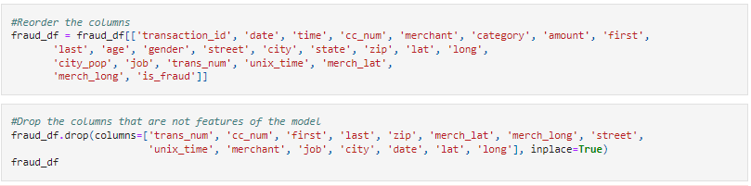
Data Cleaning
Dropped columns that were not features
Re-ordered them for SQLite preparation

Slide 9
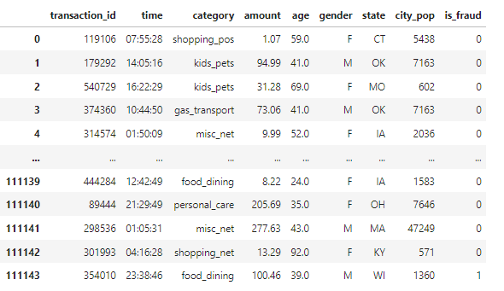
Cleaned Data

Slide 10
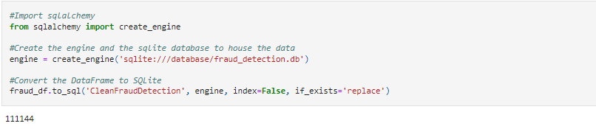
SQLite
SQLite was used to house the clean data
SQLalchemy was used to export the data into a SQLite database

Slide 11
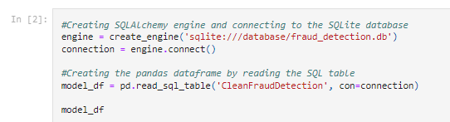
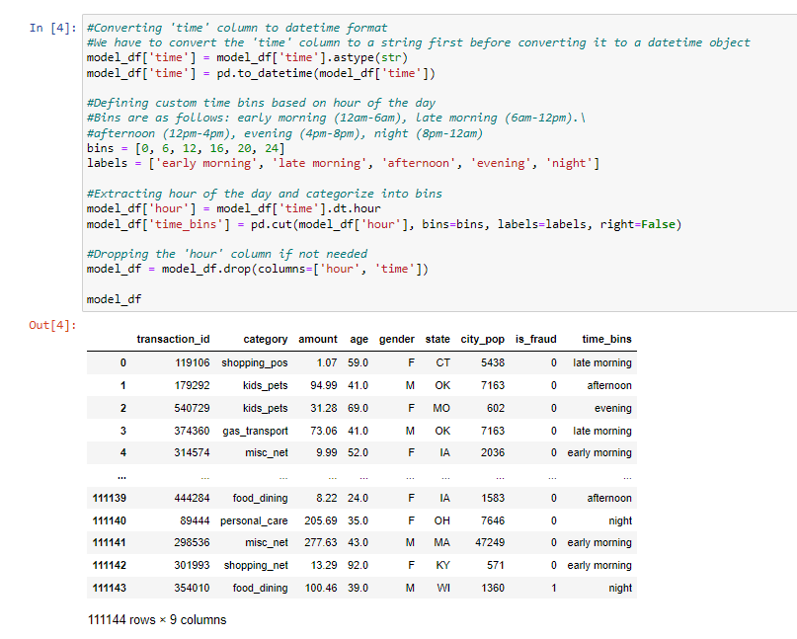
Model Creation (Logistic Regression)
Used SQLAlchemy to import data from SQLite database into Pandas
Transformed ‘time’ column
Converted the ‘time’ into date_time format
Binned the data into groups
12am-6am: early morning
6am-12pm: late morning
12pm-4pm: afternoon
4pm-8pm: evening
8pm-12am: night

Slide 12
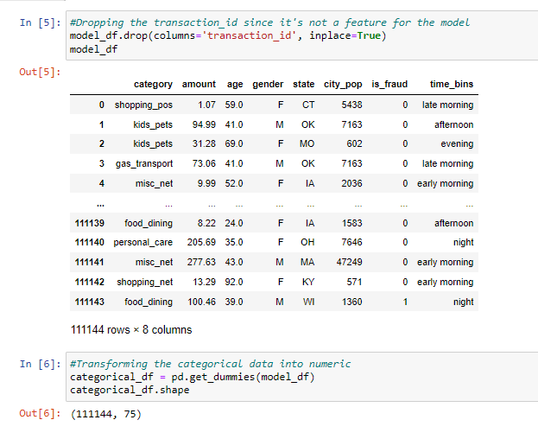
Model Creation (Logistic Regression)
Dropped ‘transaction_id’ since it’s not a feature
Used ‘pd.get_dummies’ to transform the categorical data into numeric

Slide 13

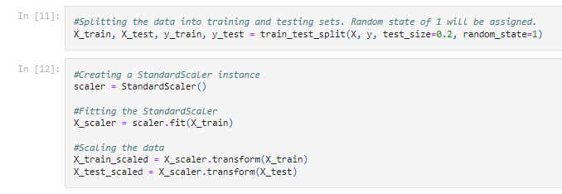
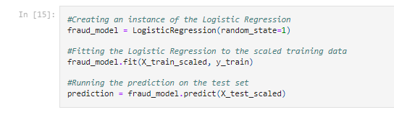
Logistic Regression - Model Compiling
Identified the Labels (fraud status column) and the features
Scaled the data
Split the data into training and testing sets

Slide 14
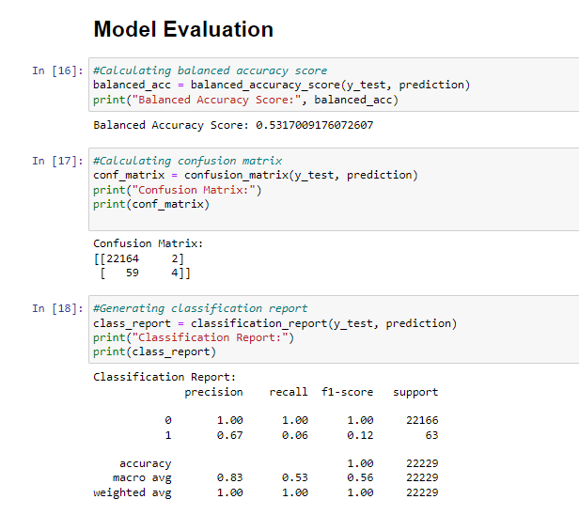
Logistic Regression - Model Performance
Balanced accuracy score of 53.1%
Very low accuracy
Confusion matrix showed very few true positives and a high amount of false negatives
Precision was high for both valid purchases and very low for fraudulent (100% vs. 6%)
Recall was high for valid purchases and very low for fraudulent (100% vs. 12%)

Slide 15
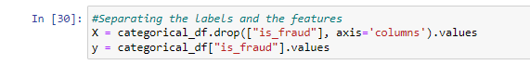
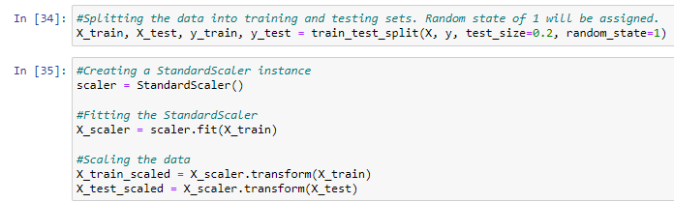
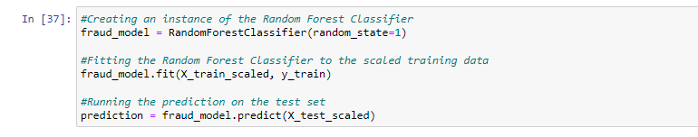
Model Creation (Random Forest)
Data cleaning same as logistic regression
Data split into test and train sets
Data scaled for model performance

Slide 16
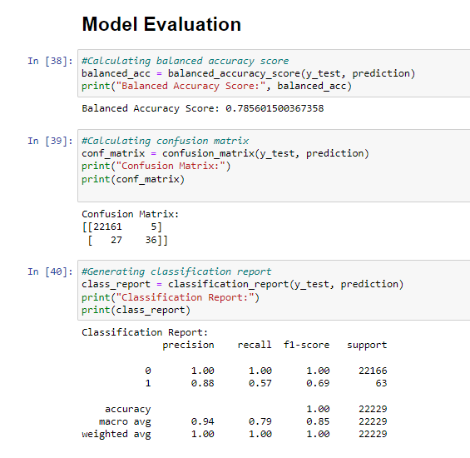
Model Creation (Random Forest)
Balanced accuracy score was significantly higher than the logistic regression
Medium accuracy of 78.5%
Confusion matrix showed an imbalance in the groups
Precision was high for both classifications
100% for valid purchases
88% for fraudulent purchases
Recall was high for valid purchases and low for fraudulent (100% vs. 57%)

Slide 17
Next Steps
Balance the ‘not fraud’ and ‘fraud’ cases
Delete fewer features

Slide 18
References
Shenoy, Kartik. (2020). Credit Card Transactions Fraud Detection Dataset. Kaggle. https://www.kaggle.com/datasets/kartik2112/fraud-detection?select=fraudTrain

